Slide 1
Express
Module 5

Slide 2
Express
Express is a fast, assertive, essential and moderate web framework of Node.js. You can assume express as a layer built on the top of the Node.js that helps manage a server and routes. It provides a robust set of features to develop web and mobile applications.
Express.js is based on the Node.js middleware module called connect which in turn uses http module. So, any middleware which is based on connect will also work with Express.js.

Slide 3
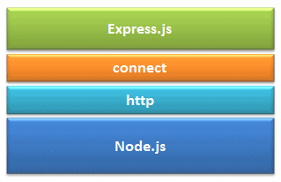
Express

Slide 4
Express
Advantages of Express.js
Makes Node.js web application development fast and easy.
Easy to configure and customize.
Allows you to define routes of your application based on HTTP methods and URLs.
Includes various middleware modules which you can use to perform additional tasks on request and response.
Another reason for using express is that it is written in javascript as javascript is an easy language even if you don't have a previous knowledge of any language. Express lets so many new developers enter the field of web development.
It saves a lot of coding time almost by half and still makes web and mobile applications are efficient.

Slide 5
Express
Installing Express:
npm init
npm install -g express
npm install express --save
body-parser: It is a node.js midlleware for handling JSON, Raw, Text and URL encoded form data
npm install body-parser --save
cookie-parser: It is used to parse Cookie header
npm install cookie-parser --save
npm install --save-dev nodemon: This allows your app to continuously update along with the changes you make in your code.

Slide 6
First App
const express = require('express')
const app = express()
const port = 3000
app.get('/', (req, res) => {
res.send('Hello World!')
})
app.listen(port, () => {
console.log(`Example app listening on port ${port}`)
})

Slide 7
Routing
const express = require('express');
const app = express();
const router = express.Router();
const port = 3000
router.get('/home', (req,res) => {
res.send('Hello World, This is home router');
});
router.get('/profile', (req,res) => {
res.send('
Hello World, This is profile router
');
});
router.get('/login', (req,res) => {
res.send('
Hello World, This is login router
');
});

Slide 8
Routing
router.get('/logout', (req,res) => {
res.send('
Hello World, This is logout router
');
});
app.use('/', router);
app.listen(port, () => {
console.log(`Example app listening on port ${port}`)
})

Slide 9
Serving Static Files
To serve static files such as images, CSS files, and JavaScript files, use the express.static built-in middleware function in Express.
The function signature is: express.static(root, [options])
var express = require('express');
var app = express();
var path = require('path');
const port = 3000
app.use(express.static(path.join(__dirname, 'public'))); // "public" off of current is root
app.listen(port, () => {
console.log(`Example app listening on port ${port}`)
})

Slide 10
http methods
Create NEW record =>POST
read=>GET
If the record exists then update else create a new record=>PUT
delete=>DELETE

Slide 11
http methods
So in order to use Express to address POST requests on our server, we use the app.post method and then we specify the route, and we have a callback.
app.post(route, function(req, res){
//this is a callback function
})

Slide 12
Routing
With POST request we can send data from client to the server, and this data is present in the request(req) object.
In order to use the data available in the req.body we will have to use a middleware express.json().
So, specify the middleware just after the express configuration i.e just after the line const app = express();
app.use(express.json());

Slide 13
Routing
app.post("/data", (req, res) => {
console.log(req.body);
res.status(200).json({ status: "Success !", data: { body:
req.body } });
});
Here, we will be reading data from the client which is present in req.body and sending the data as a response also.

Slide 14
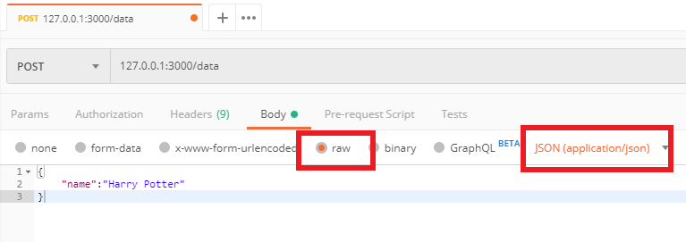
Routing

Slide 15
Routing
app.put('/user', (req, res) => {
res.send('Got a PUT request at /user')
})
app.delete('/user', (req, res) => {
res.send('Got a DELETE request at /user')
})

Slide 16
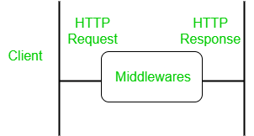
Middleware
Express.js is a routing and Middleware framework for handling the different routing of the webpage and it works between the request and response cycle. Middleware gets executed after the server receives the request and before the controller actions send the response. Middleware has the access to the request object, responses object, and next, it can process the request before the server send a response. An Express-based application is a series of middleware function calls.

Slide 17
Middleware
Advantages of using middleware:
Middleware can process request objects multiple times before the server works for that request.
Middleware can be used to add logging and authentication functionality.
Middleware improves client-side rendering performance.
Middleware is used for setting some specific HTTP headers.
Middleware helps for Optimization and better performance.

Slide 18
Middleware
Middleware Chaining: Middleware can be chained from one to another, Hence creating a chain of functions that are executed in order. The last function sends the response back to the browser. So, before sending the response back to the browser the different middleware process the request.
The next() function in the express is responsible for calling the next middleware function if there is one.
Modified requests will be available to each middleware via the next function –

Slide 19
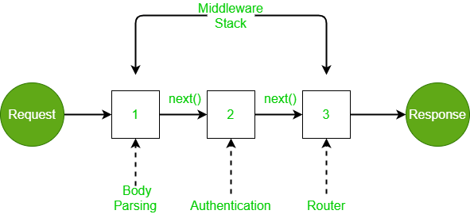
Middleware
In the above case, the incoming request is modified and various operations are performed using several middlewares, and middleware is chained using the next function. The router sends the response back to the browser.

Slide 20
Middleware
If you want to record every time you a get a request then you can use a middleware.

Slide 21
Middleware
Types of express middleware
Application level middleware app.use
Router level middleware router.use
Built-in middleware express.static,express.json,express.urlencoded
Error handling middleware app.use(err,req,res,next)
Thirdparty middleware bodyparser,cookieparser

Slide 22
Middleware
Application Level Middleware
Suppose we are having five routes getUsers,getDetails,updateDetails,isLoggedIn,isLoggedOut
every route must be authenticated if the user is not authenticated then he is not able to call the above mentioned routes,so every GET,POST calls required authentication.In this case we build a authtication middleware.
Now once the request comes the auth middleware will do some authentication logic that we have written inside it.Once authentication successful then remaining routed must be called using next()
if auth fails then it wont perform next route exit the middleware with error response logic

Slide 23
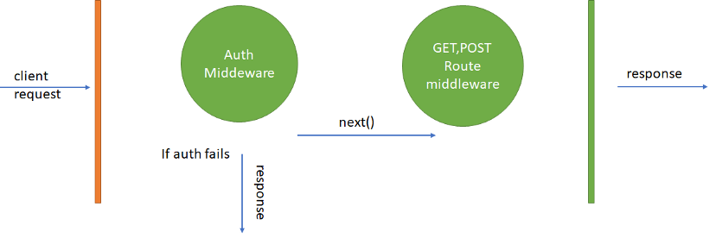
Middleware

Slide 24
Middleware
Router Level Middleware
Router-level middleware works in the same way as application-level middleware, except it is bound to an instance of express.Router().
const router = express.Router()
Load router-level middleware by using the router.use() and router.METHOD() functions.

Slide 25
Middleware
Express JS comes with default error handling params, define error-handling middleware functions in the same way as other middleware functions, except error-handling functions have four arguments instead of three:
app.use(function (err, req, res, next) {
console.error(err.stack)
res.status(500).send('Something broke!')
})

Slide 26
Cookies
cookies are small strings that contain key-value pairs of information sent from the webserver to the browser to get information about the user. The browser will then save them locally. This way, subsequent requests can be made to the server to immediately update user content on the website depending on the previous requests that a user made to the server. A cookie is HTTP generated; thus, called an HTTP cookie.

Slide 27
Cookies
When a user visits a cookie-enabled website for the first time, the browser will prompt the user that the web page uses cookies and request the user to accept cookies to be saved on their computer. Typically, when a makes a user request, the server responds by sending back a cookie (among many other things).
This cookie is going to be stored in the user’s browser. When a user visits the website or sends another request, that request will be sent back together with the cookies. The cookie will have certain information about the user that the server can use to make decisions on any other subsequent requests.

Slide 28
Cookies
When a user visits a cookie-enabled website for the first time, the browser will prompt the user that the web page uses cookies and request the user to accept cookies to be saved on their computer. Typically, when a makes a user request, the server responds by sending back a cookie (among many other things).
This cookie is going to be stored in the user’s browser. When a user visits the website or sends another request, that request will be sent back together with the cookies. The cookie will have certain information about the user that the server can use to make decisions on any other subsequent requests.

Slide 29
Cookies
Cookies are simple, small files/data that are sent to client with a server request and stored on the client side. Every time the user loads the website back, this cookie is sent with the request. This helps us keep track of the user’s actions.
The following are the numerous uses of the HTTP Cookies −
Session management
Personalization(Recommendation systems)
User tracking
To use cookies with Express, we need the cookie-parser middleware. To install it, use the following code −
npm install --save cookie-parser

Slide 30
Cookies
Now to use cookies with Express, we will require the cookie-parser. cookie-parser - cookie-parser looks at the headers in between the client and the server transactions, reads these headers, parses out the cookies being sent, and saves them in a browser. In other words, cookie-parser will help us create and manage cookies depending on the request a user makes to the server. To use it, we will require it in our index.js file; this can be used the same way as we use other middleware. Here, we will use the following code.
var cookieParser = require('cookie-parser');
app.use(cookieParser());

Slide 31
Cookies
var express = require('express');
var app = express();
app.get('/', function(req, res){
res.cookie('name', 'express').send('cookie set'); //Sets name = express
});
app.listen(3000);
To check if your cookie is set or not, just go to your browser, fire up the console, and enter −
console.log(document.cookie);

Slide 32
Generators
Express Generator is a Node.js Framework like ExpressJS which is used to create express Applications easily and quickly. It acts as a tool for generating express applications.
Features of Express-Generator:
It generates express Applications in one go using only one command.
The generated site has a modular structure that we can modify according to our needs for our web application.
The generated file structure is easy to understand.
We can also configure options while creating our site like which type of view we want to use (For example, ejs, pug, and handlebars).

Slide 33
Generators
Installation: For Installing this tool on your local machine globally (you can use it anywhere on your Machine), run the below command on your command-Line/terminal:
npm install express-generator –g
For Creating a Simple Express.js Web Application, Open command prompt/Terminal in your local fileSystem and execute the below command.
Syntax:
express <Your-ExpressJsApplication-Name>

Slide 34
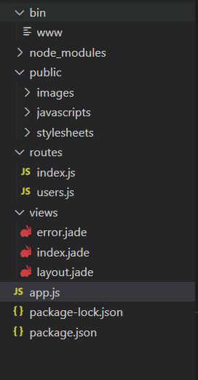
Generators

Slide 35
Generators
app.js file is the main file in the express-generator where most of the user-defined routes are handled and also provides various default imported modules like cookie-parser, morgan, etc. That helps to create an express server in an efficient manner.
Below is the default app.js file structure that is generated by the express-generator.

Slide 36
Generators
var createError = require('http-errors');
var express = require('express');
var path = require('path');
var cookieParser = require('cookie-parser');
var logger = require('morgan');
var indexRouter = require('./routes/index');
var usersRouter = require('./routes/users');
var app = express();
app.set('views', path.join(__dirname, 'views'));
app.set('view engine', 'jade');
app.use(logger('dev'));
app.use(express.json());
app.use(express.urlencoded({ extended: false }));
app.use(cookieParser());
app.use(express.static(path.join(__dirname, 'public')));
app.use('/', indexRouter);
app.use('/users', usersRouter);
app.use(function (req, res, next) {
next(createError(404));
});
app.use(function (err, req, res, next) {
res.locals.message = err.message;
res.locals.error = req.app.get('env') === 'development' ? err : {};
res.status(err.status || 500);
res.render('error');
});
module.exports = app;

Slide 37
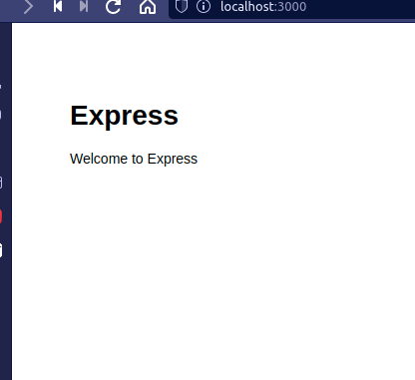
Generators

Slide 38
Session in ExpressJS
A website is based on the HTTP protocol. HTTP is a stateless protocol which means at the end of every request and response cycle, the client and the server forget about each other.
This is where the session comes in. A session will contain some unique data about that client to allow the server to keep track of the user’s state. In session-based authentication, the user’s state is stored in the server’s memory or a database

Slide 39
Session in ExpressJS
How sessions works:
When the client makes a login request to the server, the server will create a session and store it on the server-side. When the server responds to the client, it sends a cookie. This cookie will contain the session’s unique id stored on the server, which will now be stored on the client. This cookie will be sent on every request to the server.
We use this session ID and look up the session saved in the database or the session store to maintain a one-to-one match between a session and a cookie. This will make HTTP protocol connections stateful.

Slide 40
Session in ExpressJS
The difference between session and cookie:
A cookie is a key-value pair that is stored in the browser. The browser attaches cookies to every HTTP request that is sent to the server.
In a cookie, you can’t store a lot of data. A cookie cannot store any sort of user credentials or secret information. If we did that, a hacker could easily get hold of that information and steal personal data for malicious activities.

Slide 41
Session in ExpressJS
The difference between session and cookie:
On the other hand, the session data is stored on the server-side, i.e., a database or a session store. Hence, it can accommodate larger amounts of data. To access data from the server-side, a session is authenticated with a secret key or a session id that we get from the cookie on every request.

Slide 42
Session in ExpressJS
Setting up the required environments and libraries:
npm init –y
This will generate a package.json file that will manage the dependencies

Slide 43
Session in ExpressJS
Setting up the required environments and libraries:
Express-session - an HTTP server-side framework used to create and manage a session middleware.
Cookie-parser - used to parse cookie header to store data on the browser whenever a session is established on the server-side.
Install the above libraries using the command:
npm install express express-session cookie-parser

Slide 44
Session in ExpressJS
Express-session options and how to use them:
To set up the session, you need to set a couple of Express-session options, as shown below.
const oneDay = 1000 * 60 * 60 * 24;
app.use(sessions({
secret: "thisismysecrctekeyfhrgfgrfrty84fwir767",
saveUninitialized:true,
cookie: { maxAge: oneDay },
resave: false
}));

Slide 45
Session in ExpressJS
Express-session options and how to use them:
secret - a random unique string key used to authenticate a session. It is stored in an environment variable and can’t be exposed to the public. The key is usually long and randomly generated in a production environment.

Slide 46
Session in ExpressJS
Express-session options and how to use them:
resave - takes a Boolean value. It enables the session to be stored back to the session store, even if the session was never modified during the request. This can result in a race situation in case a client makes two parallel requests to the server. Thus modification made on the session of the first request may be overwritten when the second request ends. The default value is true. However, this may change at some point. false is a better alternative.

Slide 47
Session in ExpressJS
Express-session options and how to use them:
saveUninitialized - this allows any uninitialized session to be sent to the store. When a session is created but not modified, it is referred to as uninitialized.

Slide 48
Session in ExpressJS
Express-session options and how to use them:
cookie: { maxAge: oneDay } - this sets the cookie expiry time. The browser will delete the cookie after the set duration elapses. The cookie will not be attached to any of the requests in the future. In this case, we’ve set the maxAge to a single day as computed by the following arithmetic.
// creating 24 hours from milliseconds
const oneDay = 1000 * 60 * 60 * 24;

Slide 49
Session in ExpressJS
Setting up the session middleware:
To initialize the session, we will set the session middleware inside the routes of the individual HTTP requests.
When a client sends a request, the server will set a session ID and set the cookie equal to that session ID. The cookie is then stored in the set cookie HTTP header in the browser. Every time the browser (client) refreshes, the stored cookie will be a part of that request.

Slide 50
Session in ExpressJS
Setting up the session middleware:
Create an app.js file and set up the session server, as shown below.
Import all the Node.js libraries
const express = require('express');
const cookieParser = require("cookie-parser");
const sessions = require('express-session');

Slide 51
Session in ExpressJS
Setting up the session middleware:
Initialize the express app
const app = express();
const PORT = 4000;

Slide 52
Session in ExpressJS
Setting up the session middleware:
Add the Express-session options
// creating 24 hours from milliseconds
const oneDay = 1000 * 60 * 60 * 24;
//session middleware
app.use(sessions({
secret: "thisismysecrctekeyfhrgfgrfrty84fwir767",
saveUninitialized:true,
cookie: { maxAge: oneDay },
resave: false
}));

Slide 53
Session in ExpressJS
Setting up the session middleware:
Parse the HTML form
This will help us parser an HTTP POST method request from an HTML document. We also need to serve the CSS styling to format the outlook of the HTML form. Add the following express methods to perform these operations.
// parsing the incoming data
app.use(express.json());
app.use(express.urlencoded({ extended: true }));
//serving public file
app.use(express.static(__dirname));

Slide 54
Session in ExpressJS
Setting up the session middleware:
Set the Cookie-parser
Define Cookie-parser usage so that the server can access the necessary option to save, read and access a cookie.
// cookie parser middleware
app.use(cookieParser());

Slide 55
Session in ExpressJS
Setting up the session middleware:
Set the authentication credentials
In this example, we are using a simple login application. To authenticate the user, the username and password are specified as user1 and mypassword, respectively in this file as variables.
In a production environment, these credentials are usually saved in a database. For the sake of simplicity in this tutorial, we are storing them in these variables.

Slide 56
Session in ExpressJS
Setting up the session middleware:
//username and password
const myusername = 'user1'
const mypassword = 'mypassword'
// a variable to save a session
var session;

Slide 57
Session in ExpressJS
Setting up the session middleware:
Add the endpoints
We have to make three routes here:
http://localhost:4000/
This will render and serve the HTML form to the client to fill in the login credentials. If the user is logged in, we’ll display a logout link.
app.get('/',(req,res) => {
session=req.session;
if(session.userid){
res.send("Welcome User <a href=\'/logout'>click to logout</a>");
}else
res.sendFile('views/index.html',{root:__dirname})
});

Slide 58
Session in ExpressJS
Setting up the session middleware:
http://localhost:4000/user
To create a session, the user will submit the credentials. The server will verify these credentials received in the request’s body with the username and the password for the existing user.
If the credentials are valid:
The user will be granted the necessary access.
The server will create a temporary user session with a random string known as a session ID to identify that session.
The server will send a cookie to the client’s browser. The session ID is going to be placed inside this cookie.

Slide 59
Session in ExpressJS
Setting up the session middleware:
Once the client browser saves this cookie, it will send that cookie along with each subsequent request to the server. The server will validate the cookie against the session ID. If the validation is successful, the user is granted access to the requested resources on the server.
If the credentials are invalid, the server will not grant this user access to the resources. No session will be initialized, and no cookie will be saved.

Slide 60
Session in ExpressJS
Setting up the session middleware:
app.post('/user',(req,res) => {
if(req.body.username == myusername && req.body.password == mypassword){
session=req.session;
session.userid=req.body.username;
console.log(req.session)
res.send(`Hey there, welcome <a href=\'/logout'>click to logout</a>`);
}
else{
res.send('Invalid username or password');
}
})

Slide 61
Session in ExpressJS
Setting up the session middleware:
http://localhost:4000/logout
This will define the logout endpoint. When the user decides to log out, the server will destroy (req.session.destroy();) the session and clear out the cookie on the client-side. Cookies are cleared in the browser when the maxAge expires.
app.get('/logout',(req,res) => {
req.session.destroy();
res.redirect('/');
});

Slide 62
Session in ExpressJS
Setting up the session middleware:
Listen to the port of the server
app.listen(PORT, () => console.log(`Server Running at port ${PORT}`));
Your session application is now set. Run the application using:
node app.js
Once you log in successfully, a session will be generated, and a cookie will be saved in the browser.
In this case, since we don’t have a database to save the session, we will console.log(req.session) and glance at how it looks. If you go back to the command line, the session object will be printed to the console.
These are the same values you would have saved in a production environment on the server-side into a database such as MongoDB, PostgreSQL, etc.

Slide 63
Session in ExpressJS
Setting up the session middleware:
Open the browser inspector tool > application > Cookies http://localhost:4000/.
Every time you refresh this page, the request will be sent along with the value of this cookie within this localhost domain. If it matches with the session stored value, the server will authenticate this user.
It’s not a security concern if a third party can read the cookies.
The client won’t be able to modify the contents of the cookie, and even if they try to, it’s going to break the signature of that cookie. This way, the server will be able to detect the modification.

Slide 64
Session in ExpressJS
Setting up the session middleware:
A cookie doesn’t carry any meaningful data inside of them. It just contains the session ID token. The cookie is encrypted. It still has to maintain a one-to-one relationship with the user session. The cookie will be valid until set maxAge expires or the user decides to log out.
When the user logs out, the session will be destroyed. There is no session to compare with the saved cookie. The user will have to log in again to create a session ID for the new login session.

Slide 65
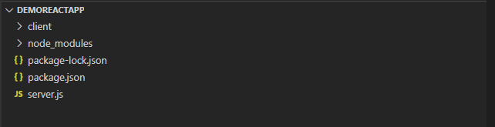
Integrating with React
Setting up the folder structure:
The first step would be to create a root folder for our case, demoreactapp, to hold all of our App’s files. Then we will have the client directory that will hold all the React App files.
The node_modules folder will contain all NPM packages for our server.js file. The node_modules folder will be auto-generated when we install NPM packages.

Slide 66
Integrating with React
Setting up the folder structure:
Next will need to create a server.js file. The file will contain an Express server that will act as our backend. The package.json file is auto-generated when the npm init -y command is run in the terminal.

Slide 67
Integrating with React
Creating the React app:
From the terminal, browse to the root directory using the cd command and run the below commands:
$cd demoreactapp
$npx create-react-app client
The above commands will create a react app with the name client inside the root directory.

Slide 68
Integrating with React
Setting up the Express server:
The next step involves creating an Express server in the file server.js.
Browse to the root directory from the terminal and run the command mentioned below:
$npm init -y
The command will auto-generate the package.json file. Next will will need to run the command below to install Express and it will be saved as a dependency inside the package.json.
$npm install express --saveFrom the terminal, browse to the root directory using the cd command and run the below commands:
$cd demoreactapp
$npx create-react-app client
The above commands will create a react app with the name client inside the root directory.

Slide 69
Integrating with React
Setting up the Express server:
Now edit the file server.js as shown below:
const express = require('express'); //Line 1
const app = express(); //Line 2
const port = process.env.PORT || 5000; //Line 3
// This displays message that the server running and listening to specified port
app.listen(port, () => console.log(`Listening on port ${port}`)); //Line 6
// create a GET route
app.get('/express_backend', (req, res) => { //Line 9
res.send({ express: 'YOUR EXPRESS BACKEND IS CONNECTED TO REACT' }); //Line 10
}); //Line 11

Slide 70
Integrating with React
Setting up the Express server:
Line 1 and 2 - requires Express and allows us to use it inside our server.js file.
Line 3 – It will set the Express server on which port it will run on.
Line 6 – will display a message on the console that the server is working as expected.
Line 9 to 11 – It will set a GET route that we will, later on, fetch from our client-side React App.

Slide 71
Integrating with React
Setting up the proxy:
In this step, the Webpack development server was auto-generated when we ran the create-react-app command. Our react App is running on the Webpack development server on the frontend.
We can proxy the API requests from the client-side to the API on the server-side. The API on the server-side (Express server) will be running on port 5000.
Webpack Development Server (WDS) is a tool that helps the developers make changes to the web app’s frontend and renders them to the browser with no need to refresh the browser.
It’s unique compared to other tools that do the same in the way that the bundle contents are not written out as files on the disk but are stored in the memory. This advantage is vital when one is trying to debug the code and styles.

Slide 72
Integrating with React
Setting up the proxy:
First, set up the proxy to navigate the client directory and locate its package.json file. Add the line below to it.
“proxy”: “http://localhost:5000”
The modified package.json file will look as shown below:
The modified package.json file will let the webpack proxy the API requests to the Express backend server running on port 5000.

Slide 73
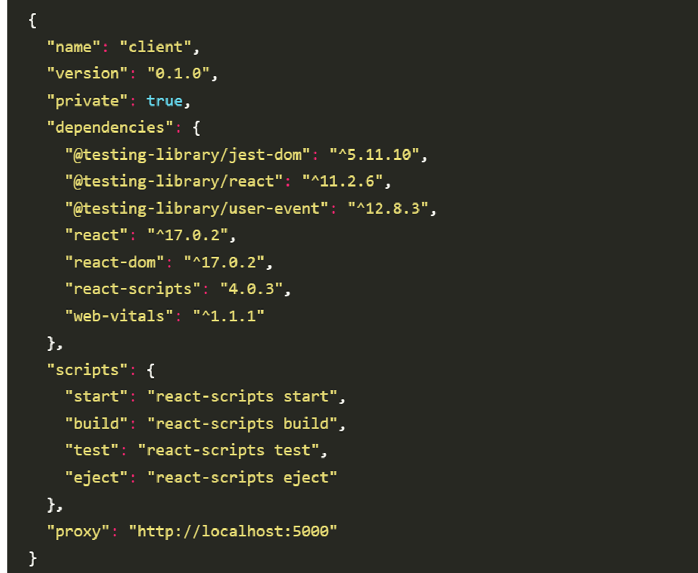
Integrating with React
Setting up the proxy:

Slide 74
Integrating with React
Calling Express backend server from React:
First is to browse into client/src and edit the file App.js to appear as below:

Slide 75
import React, { Component } from 'react';
import logo from './logo.svg';
import './App.css';
class App extends Component {
state = {
data: null
};
componentDidMount() {
this.callBackendAPI()
.then(res => this.setState({ data: res.express }))
.catch(err => console.log(err));
}
// fetching the GET route from the Express server which matches the GET route from server.js
callBackendAPI = async () => {
const response = await fetch('/express_backend');
const body = await response.json();

Slide 76
if (response.status !== 200) {
throw Error(body.message)
}
return body;
};
render() {
return (
<div className="App">
<header className="App-header">
<img src={logo} className="App-logo" alt="logo" />
<h1 className="App-title">Welcome to React</h1>
</header>
<p className="App-intro">{this.state.data}</p>
</div>
);
}
}
export default App;

Slide 77
Integrating with React
Calling Express backend server from React:
Inside of componentDidMount(), the function callBackendAPI() is called. This function will fetch the route previously created in the Express server and then set{data: null} to the fetch request-response.
On the line that contains this.state.data inside the render function, it renders new data to the DOMFirst is to browse into client/src and edit the file App.js to appear as below:

Slide 78
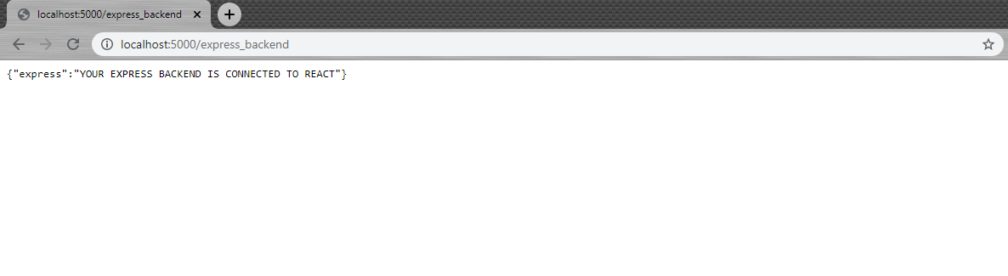
Integrating with React
Running the app:
We navigate to the root directory demoreactapp and run the command below:
$cd demoreactapp
$node server.js
After running the file server.js, next we will go to our browser, “http://localhost:5000/express_backend”, and the message below will be displayed:

Slide 79
Integrating with React
Running the app:
The above shows that our Express server is working as expected and that the GET route we created is working, and it is possible to fetch the route from the client-side.
Also, note the URL path is the same as the path we set in our GET route in the server.js file.
Next, browse to the client directory in the terminal, and run the below commands:
$cd client
$npm start

Slide 80
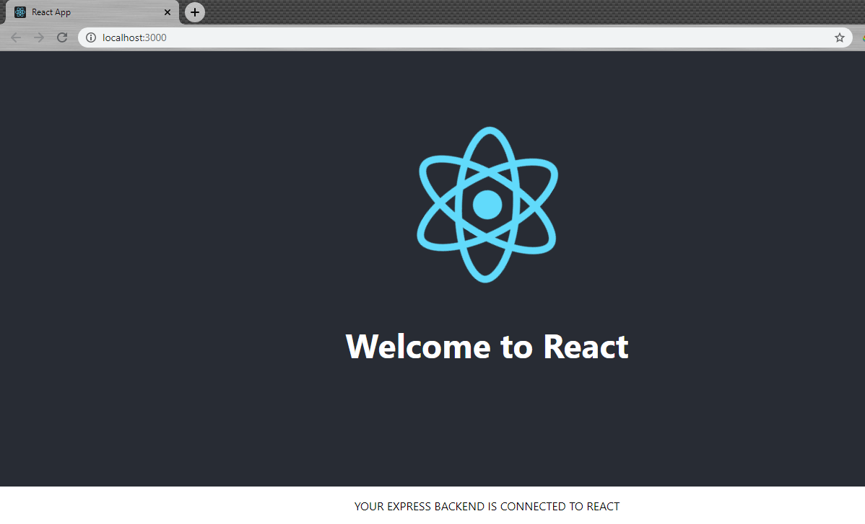
Integrating with React
Running the app:
The commands above will run the React Dev server, which runs on port 3000, and automatically open in the web browser.
The screen below with a message will be displayed:

Slide 81
Integrating with React
Running the app:
Finally, we have rendered the data fetched from the GET route in server.js to our frontend React App, as demonstrated above.
If the Express server is disconnected, the React server will continue running. However, the connectivity to the backend will be lost, and nothing will be displayed.

